Slide 1


The Finance Domain:
What is Finance?
Finance is the field that focuses on how money is managed — whether it's for a person, a company, or a government. It answers questions like:
Where does the money come from?
How should it be invested?
How should it be spent to maximize value?
by safa ali

Slide 2

Main Branches of Finance :
1. Corporate Finance
2. Investment Finance
This deals with managing money inside companies, and includes:
This focuses on investing in markets to grow wealth. People in this field:
Investment decisions (e.g., which project to fund)
Analyze stocks, bonds, real estate, etc.
Build and manage investment portfolios
Budgeting and forecasting
Evaluate risk vs return
Financial reporting and analysis
Managing risk and profitability
3. Personal Finance
Helps individuals manage their money wisely. Includes:
Budgeting
Saving and investing
Retirement planning
Debt management
These KPIs ensure a company's ability to meet short-term obligations without financial stress.

Slide 3

What Does Finance Look Like in a Bank?
In a bank, finance isn’t just about “money” — it’s about how money is managed, analyzed, and controlled both inside the bank and for its customers.
There are two main areas:
Internal Bank Finance – managing the bank’s own money
Financial Analyst
Tracks the bank’s income, expenses, profit, and financial health. Builds reports and dashboards for management.
Risk Analyst
Identifies financial risks (e.g., credit defaults, interest rate changes) and recommends ways to reduce them.
Treasury Analyst
Manages the bank’s liquidity — how much cash it has on hand — and its investments or funding.
Compliance & Audit
Ensures the bank follows all financial regulations. Monitors transactions to prevent fraud or money laundering.

Slide 4
Client-Facing Financial Services – helping clients manage, grow, or borrow money
Loan Officer
Reviews applications for personal, business, or mortgage loans. Uses financial data to assess eligibility.
Relationship Manager
Works with high-value clients to manage accounts, investments, and credit.
Wealth Manager / Financial Advisor
Helps clients grow their money through investments, savings plans, insurance, etc.
Credit Analyst
Assesses whether a customer or business can repay their loan. Uses data like income, debt, and credit history.

Slide 5
Profitability KPIs: Measuring Financial Performance
15%
45%
Customer KPIs:
Account KPIs:
New customers per month/year → Track growth in customer base.
Total number of accounts by type (Savings, Business).
Average customer tenure → Measure loyalty (based on Join Date).
Average balance per account type.
Customer churn rate → Identify % of customers who closed accounts (if closure data is available).
Number of high-balance accounts (e.g., >50,000).
Customer segmentation by account type, loan type, or card type.
Account growth rate → New accounts opened over time
$20M
Transaction KPIs:
Loan KPIs:
Total transaction volume (amount) per month/year.
Total loan portfolio size → Sum of Loan Amount.
Average transaction value per type (Deposit, Transfer, etc.).
Average interest rate by loan type.
Number of transactions per customer → Engagement level.
Default rate (if you have repayment status).
Failed vs successful transactions (if data allows)
Active loans by type (Car, Personal, Home)
Card KPIs:
Support KPIs:
Number of cards issued by type (Debit, Prepaid).
Total support calls per month.
Active vs expired cards → Check Expiration Date.
Resolution rate → % of Resolved = Yes.
Average card lifespan → From Issued Date to Expiration Date.
Average resolution time (if call duration data is available).
Top issue types → Frequency of Issue Type.

Slide 6
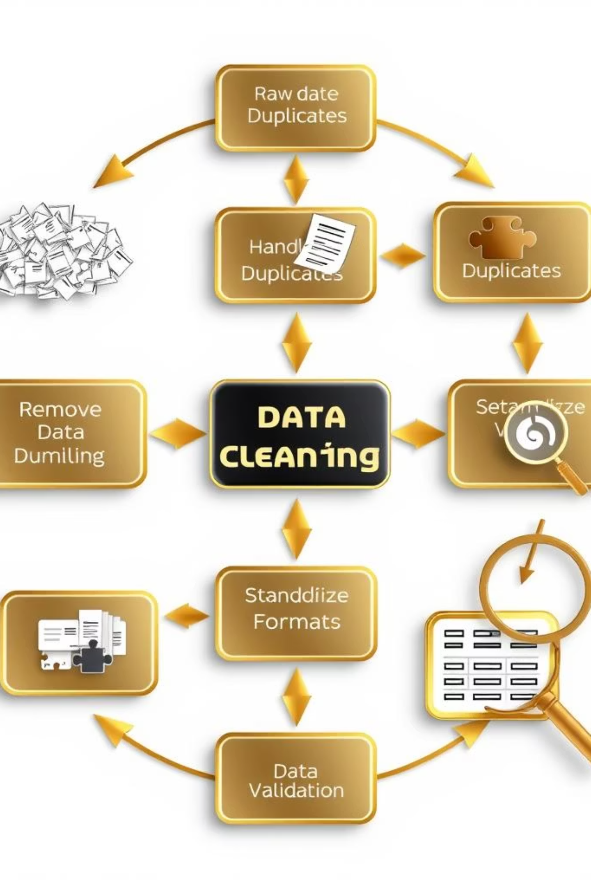
Project Steps: First - Data Cleaning Using Power Query:

Slide 7
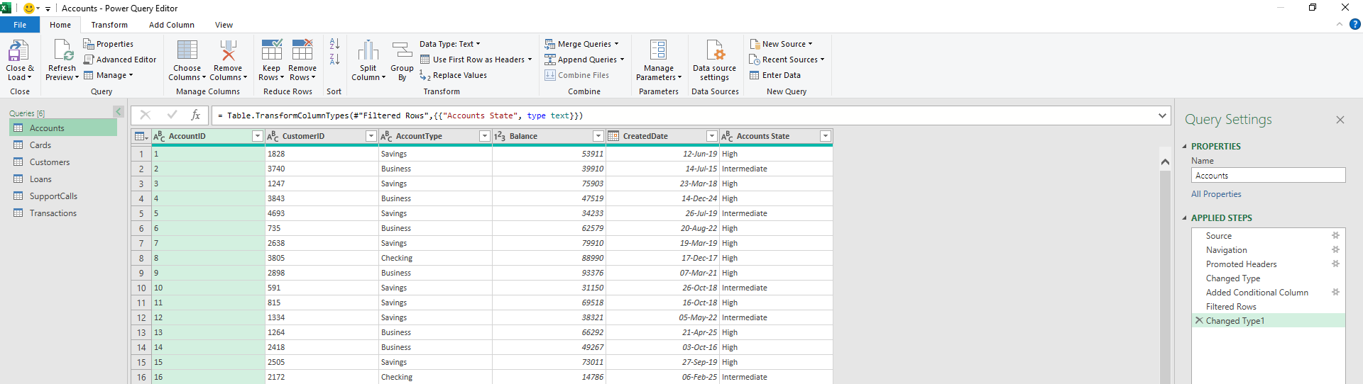

Slide 8
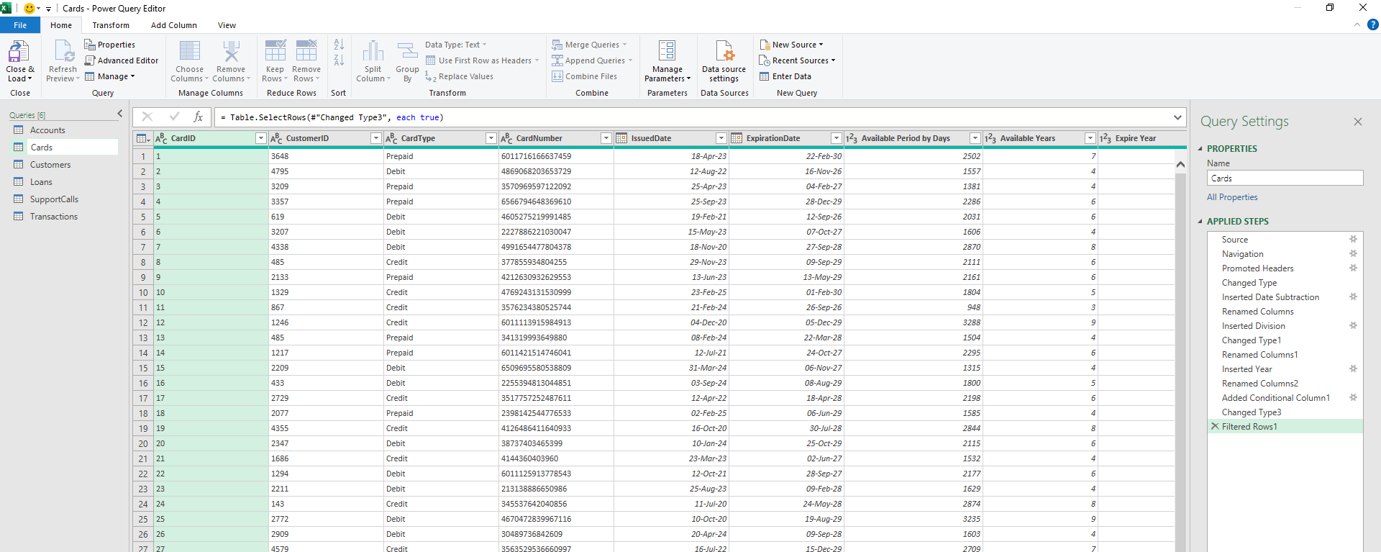

Slide 9
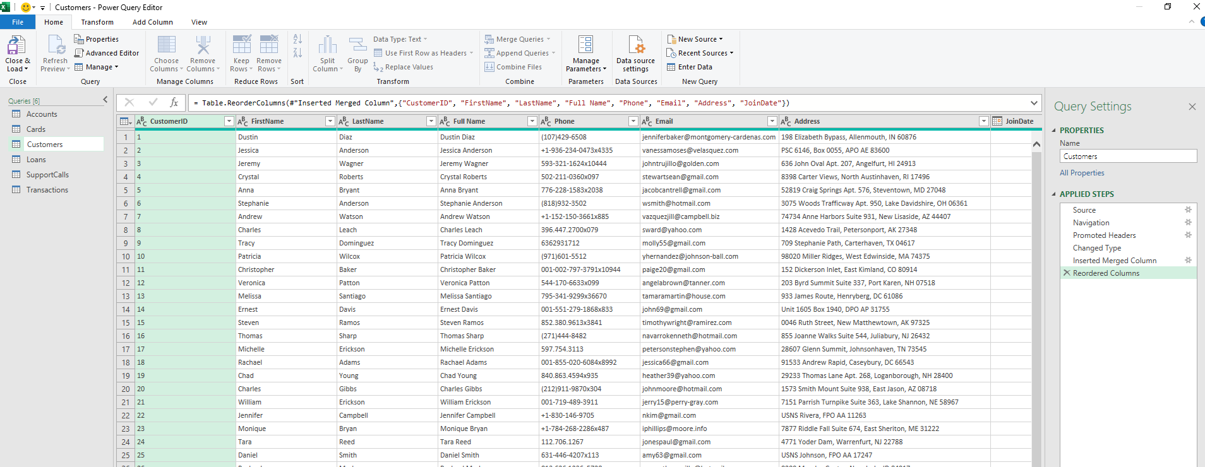

Slide 10
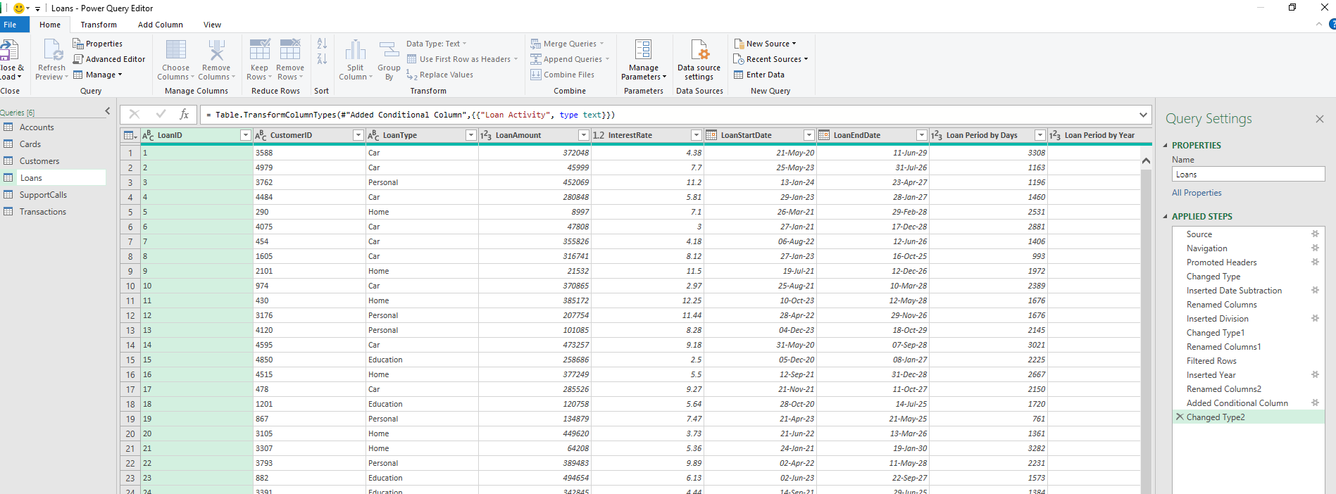

Slide 11
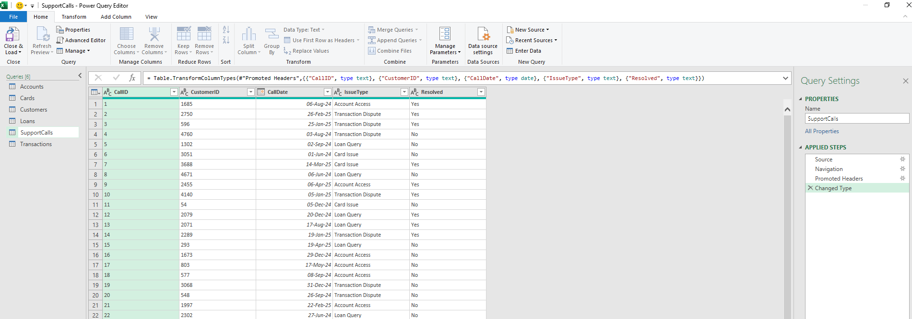

Slide 12
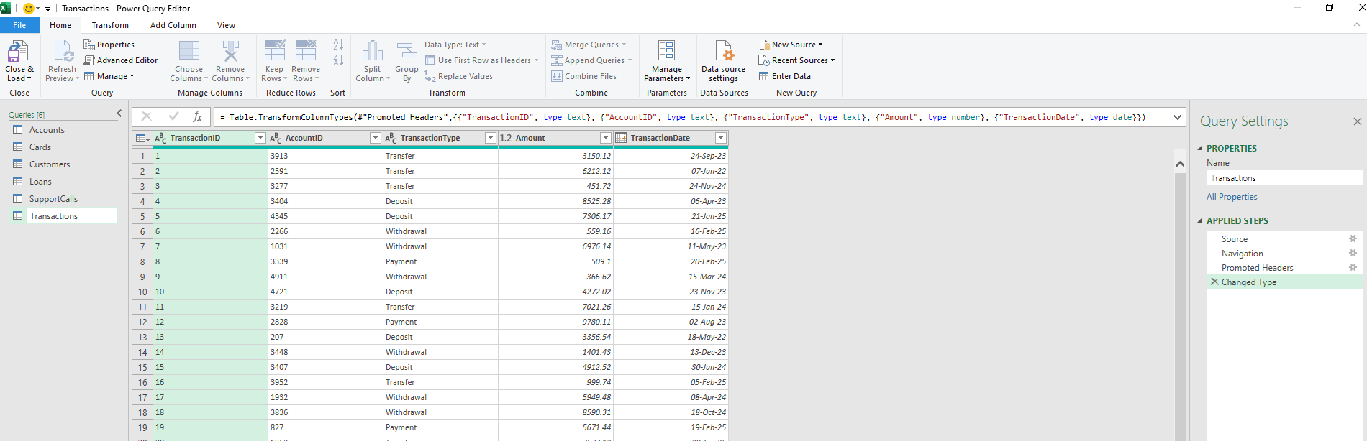

Slide 13
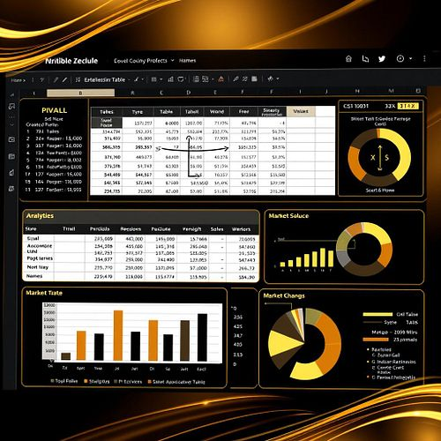
Second - Pivot Tables and Data Modeling

Slide 14
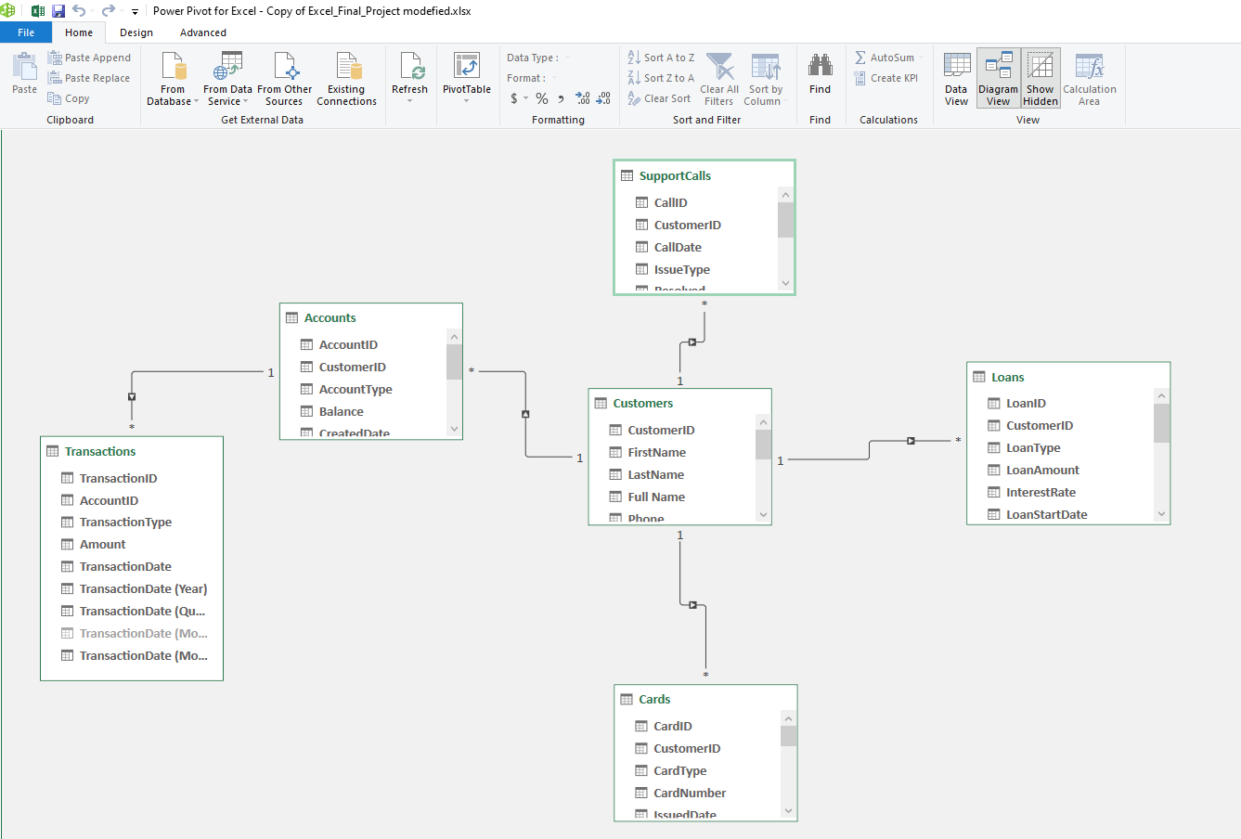

Slide 15
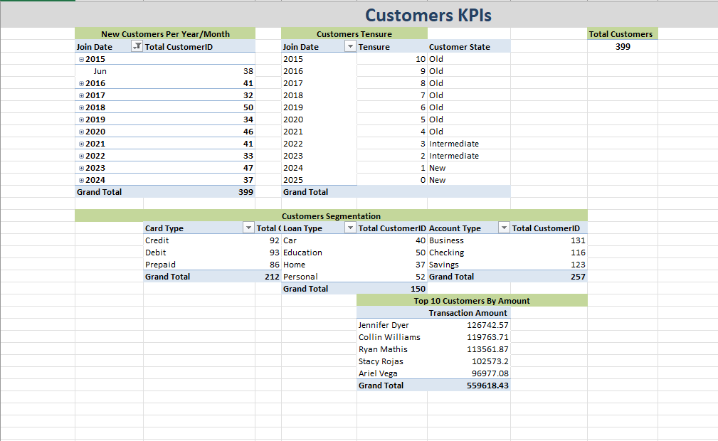

Slide 16
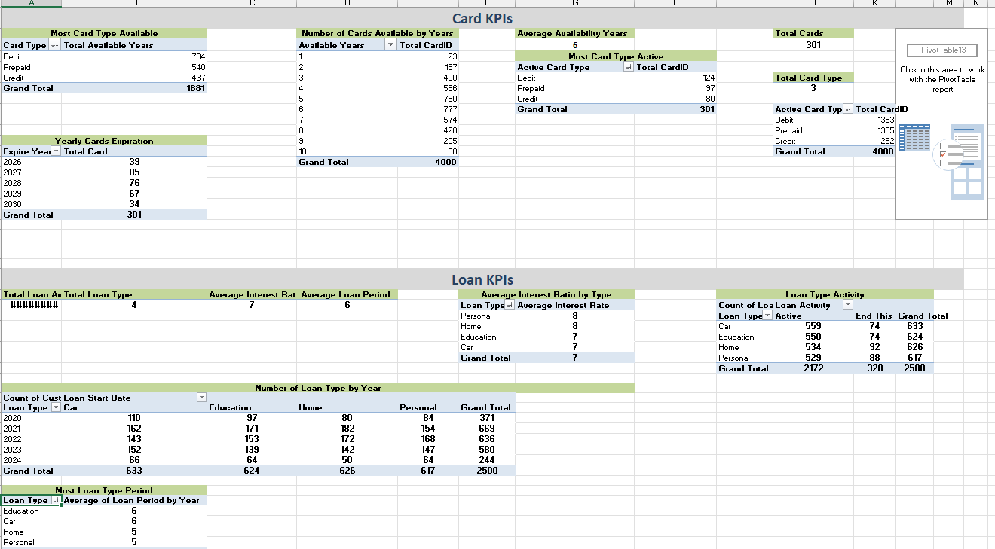

Slide 17
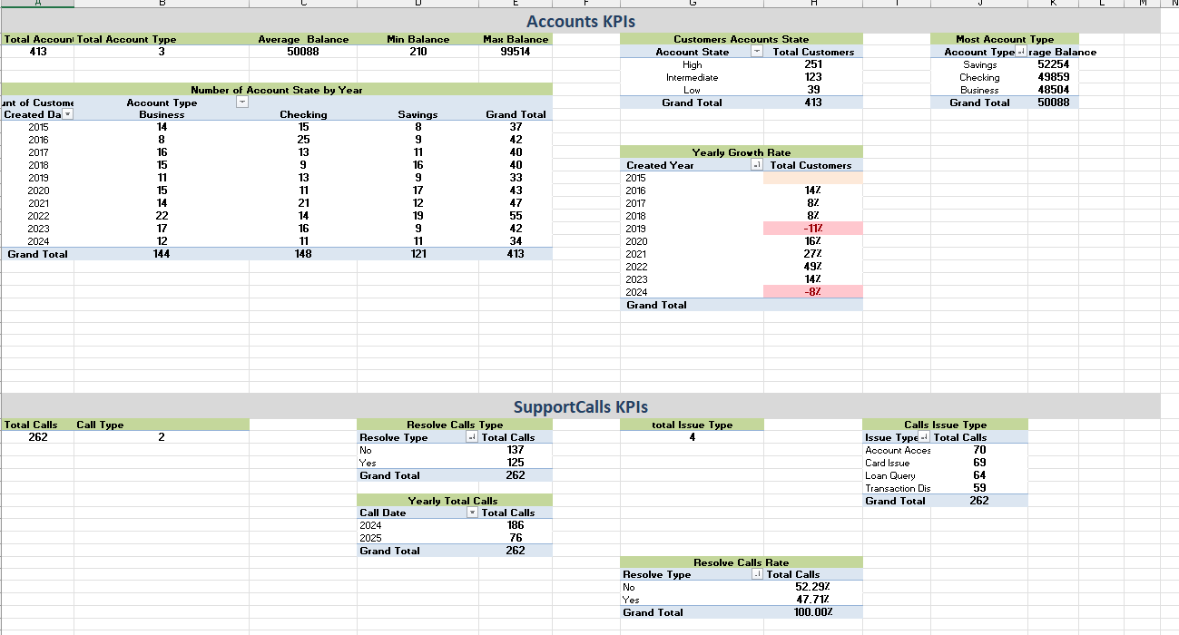

Slide 18
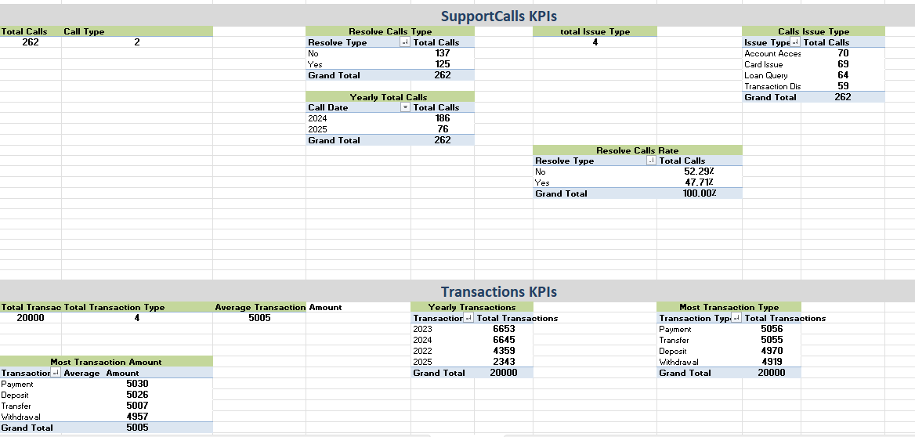

Slide 19
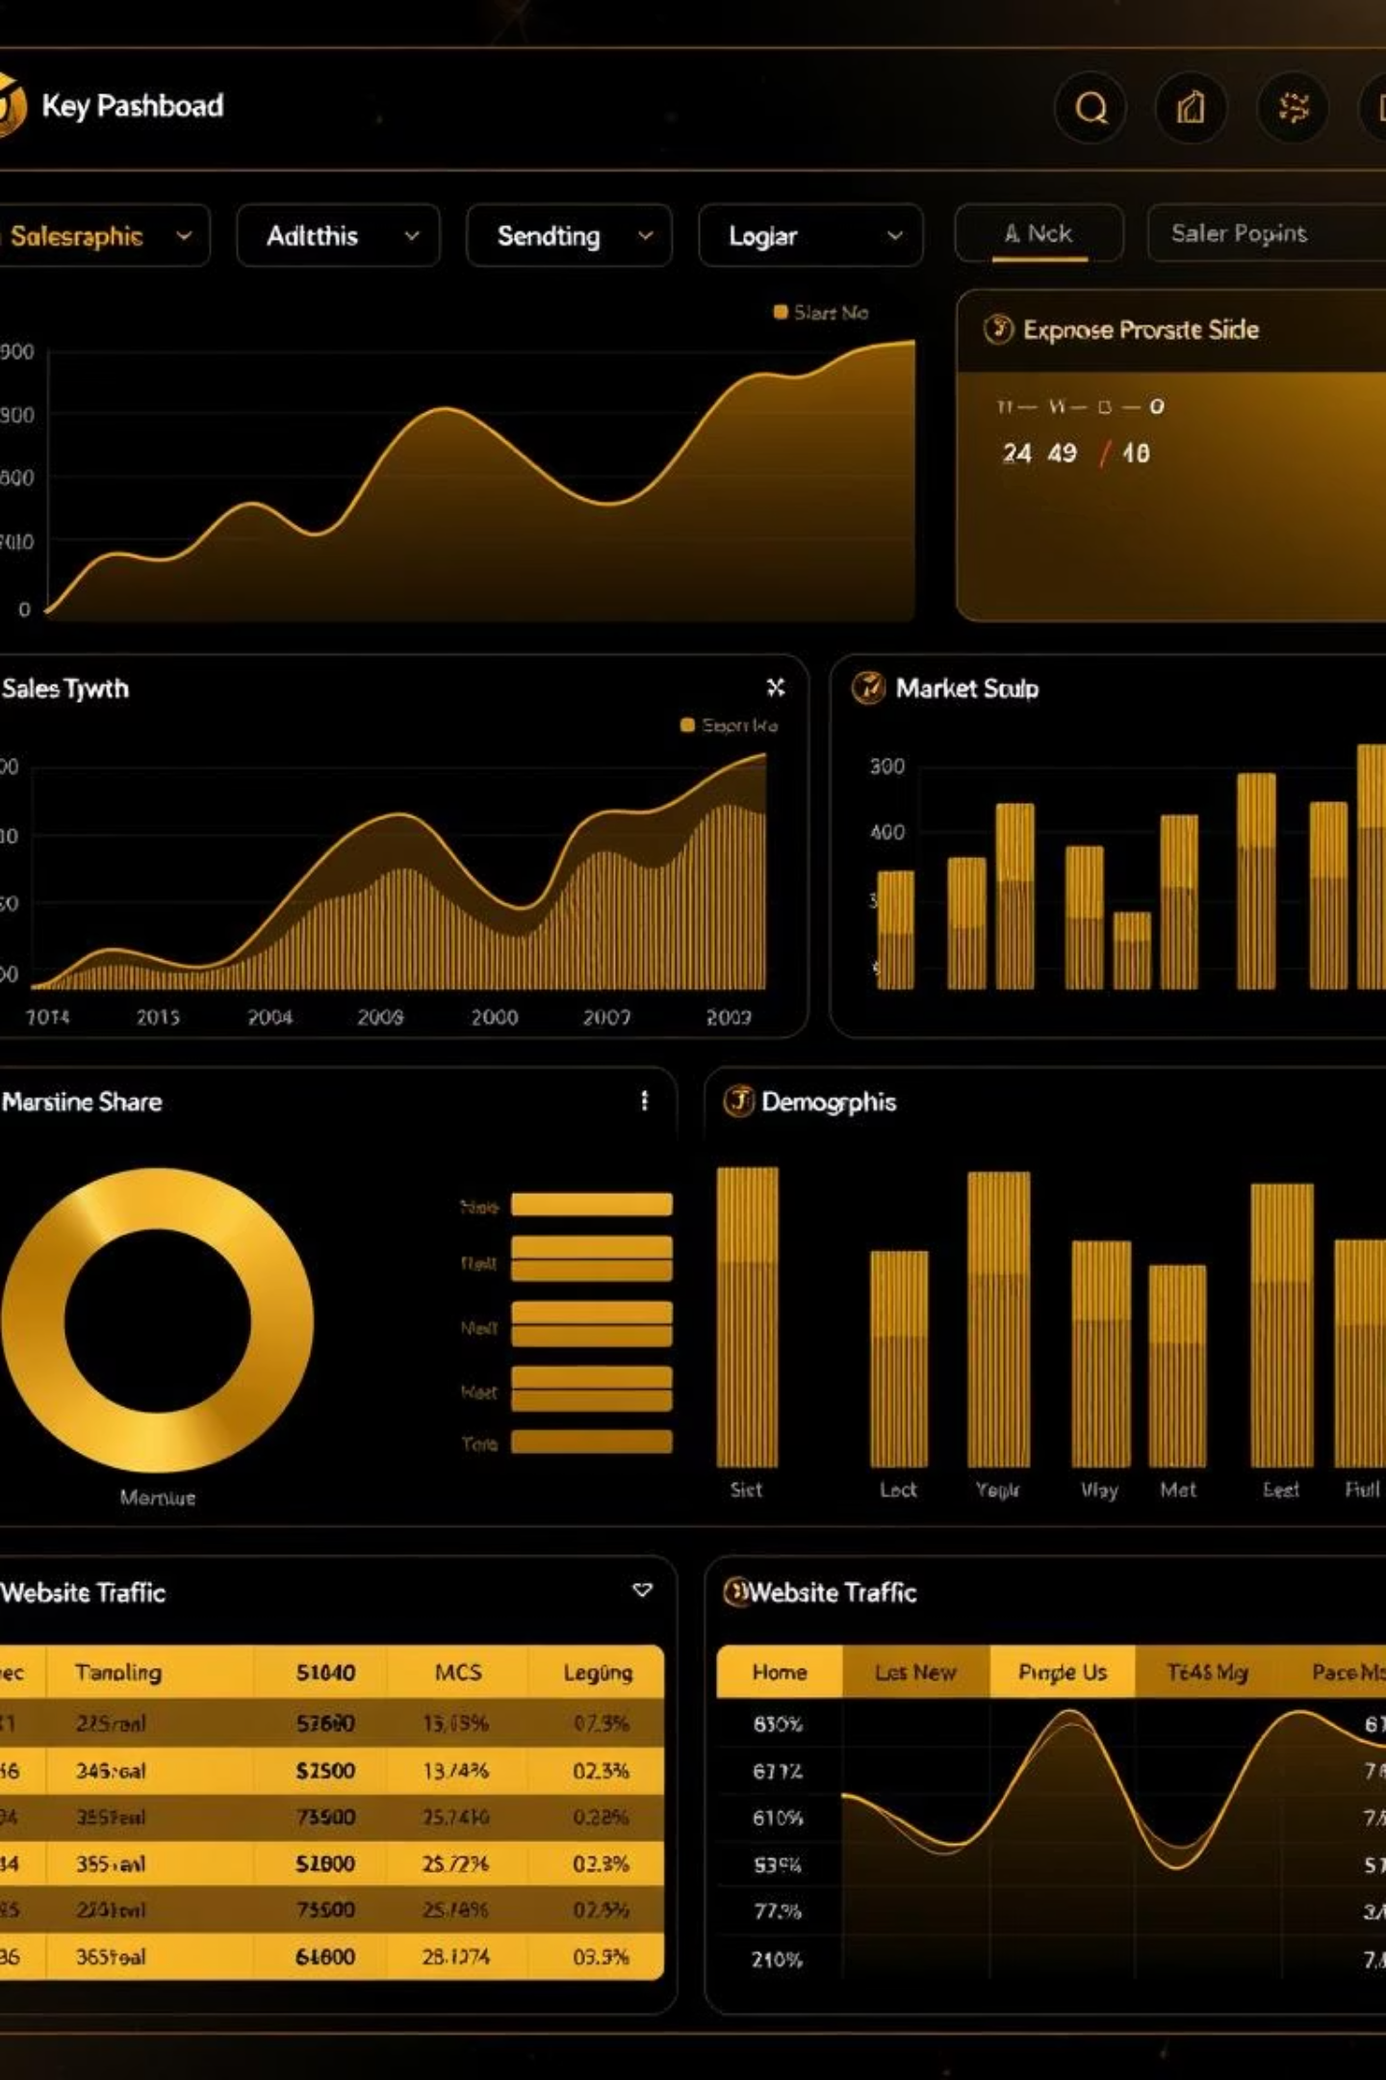
Finally - Creating Dashboard

Slide 20


Slide 21
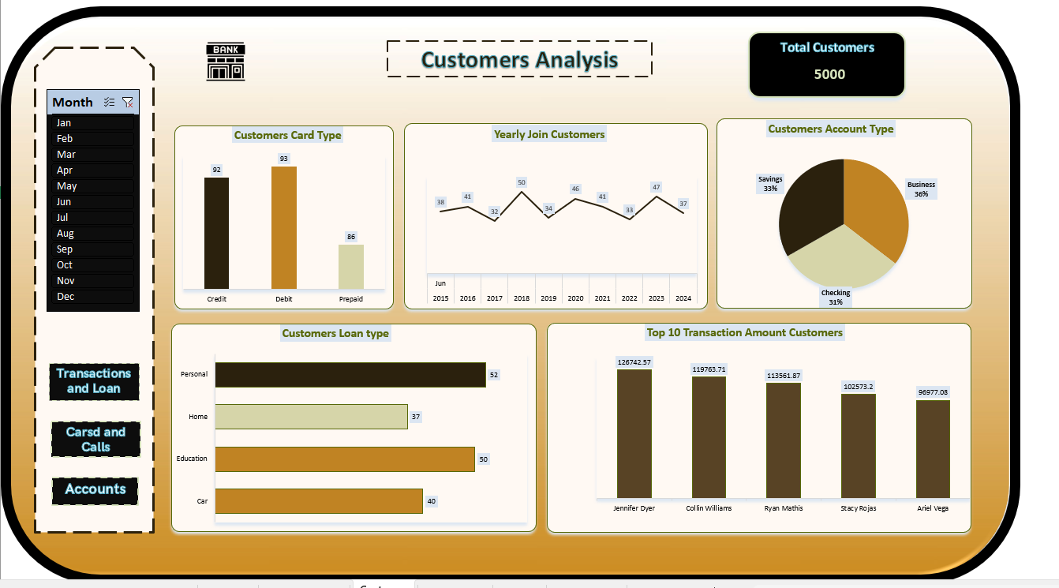

Slide 22
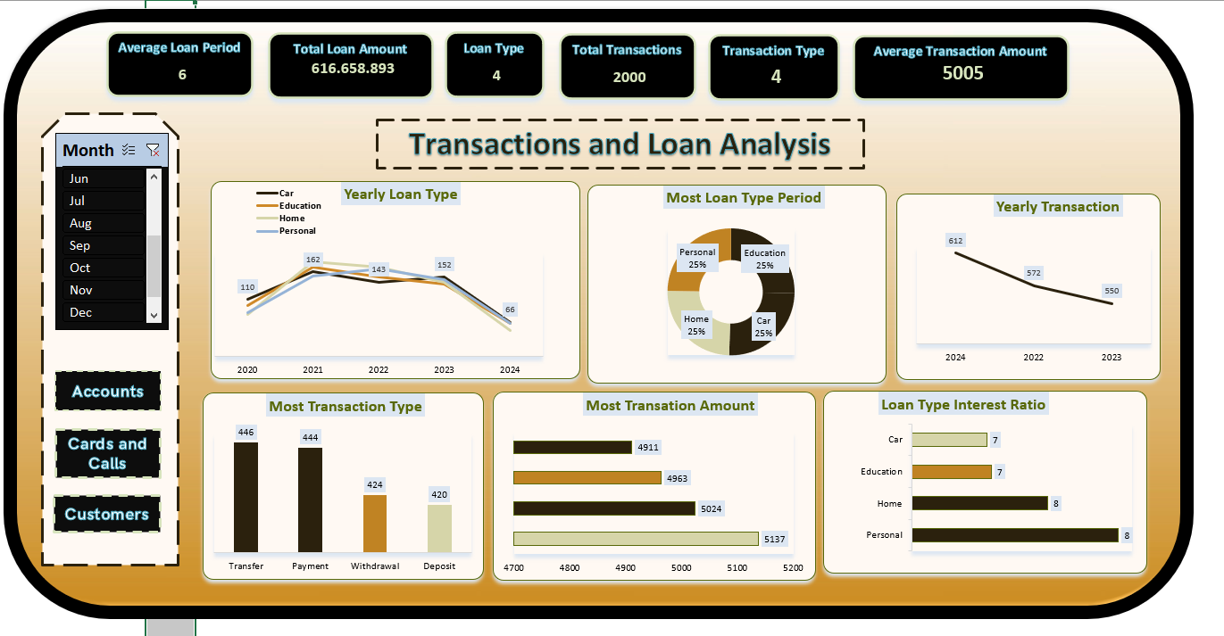

Slide 23
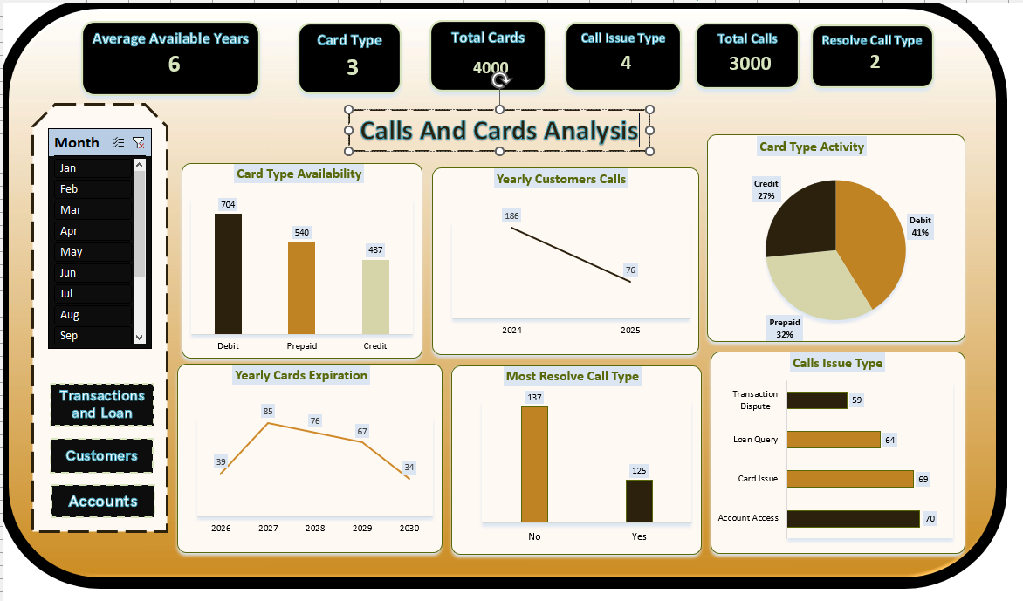

Slide 24
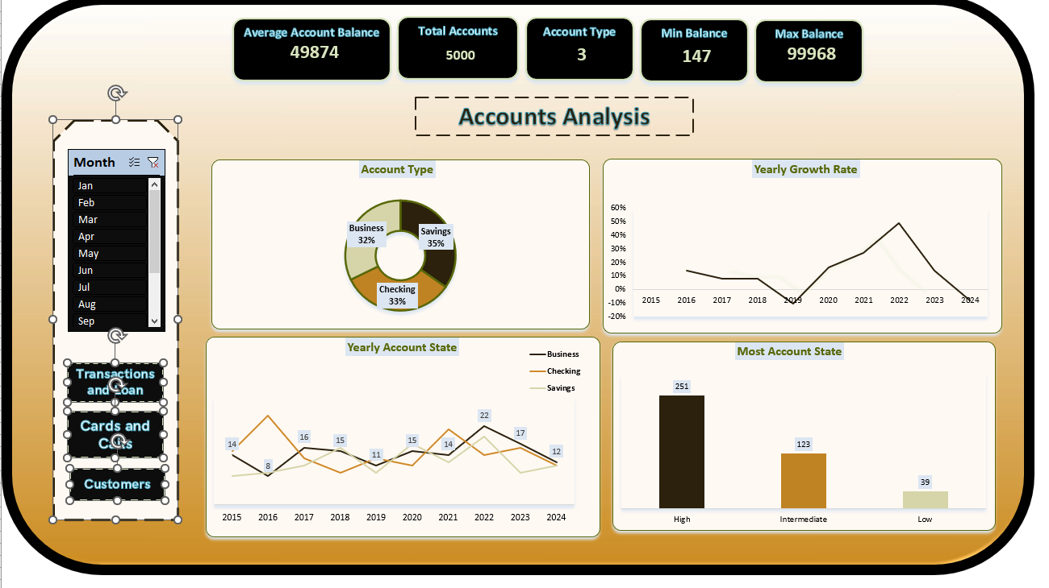

Slide 25


